Slide 1
Group 7 – Project
Title: Newton University
By
Aman Chandrakar
Manav Deshmukh
Syed Jaffer Hussain
Vishakha Kharpate
Guided by Dr. Toni Waggoner

Slide 2
Was there something we wanted to do in Access but could not figure it out?
While creating form for data insertion we tried to create it by “insert” query in SQL, but it did not work out as we were not able to build the form on insert query, so we used default method of Access-data entry operation to create the form. (..Ctd)

Slide 3
In form creation process : we were unable to change the border color of textboxes and it wasn’t possible to implement the text placeholder.
We wished to implement trigger to check whether the Course is Prerequisite or not, but MS Access does not support this functionality.

Slide 4
What was the hardest task for us to complete in Access?
Initially, there were some minor problem in implementing security in access, but later as we got used to work in Access we were able to implement the same by visual basic code with help of SQL Query.

Slide 5
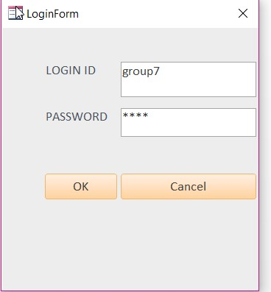
We implemented security in two levels
Admin Level: all authorities’ permission, generating report, forms and processing queries

Slide 6
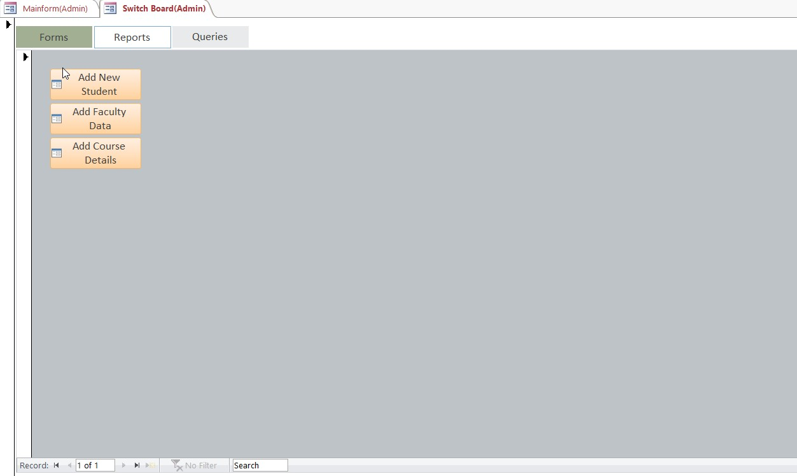
Switch board for Admin:

Slide 7
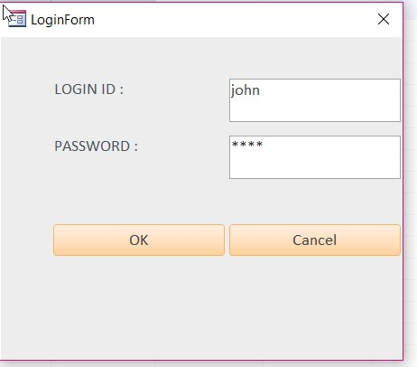
User Level: permission for generating report and
processing queries except generating form

Slide 8
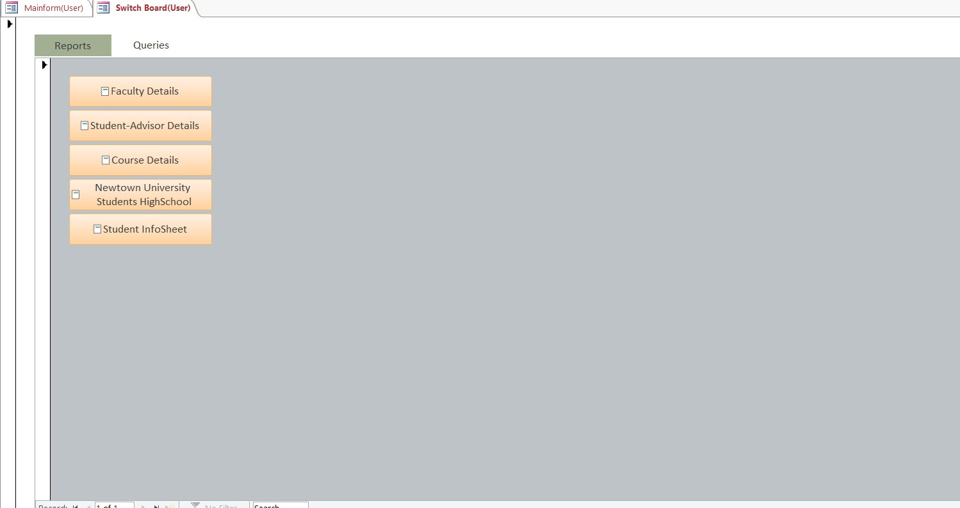
Switch board for User:

Slide 9
Was there something that we accomplished in an unusual or really “slick” way?
Reports, since it did not take much time, we just had to write the queries and build report on it, even the addition of print button and formatting of report was an easy task to do. (..Ctd.)

Slide 10
Parameterized query creation became very simple with the help of handout on parameterized query provided by our Professor .
It was achieved in less time.

Slide 11
Were there any problems with completing this project within a group setting?
One of our team member resides in different city, sometimes it would become difficult to communicate with him, but thanks to technology, we shared a lot of ideas using Skype and FaceTime. This helped in understanding the project requirements and we accomplished our group meetings. File exchanges with the TeamViewer assisted in doing our work efficiently . (..Ctd)

Slide 12
Since it was quite a task to work in Access, we were not able to work concurrently, we tried working in box together but it did not work well as it was very time consuming, sometimes the data was not reflected in other system even after saving it.
As team member , there weren’t any issues and all coordinated very well and had mutual understanding.

Slide 13
General Comments Regarding The Process of Our Group
Every individual of the group was given a task in the beginning, the idea was to make sure everyone has a contribution at each level of the project design. As we progressed with executing those ideas with the help of Project discussions & weekly meetings, in the end, all our team member contributed to the project very conveniently. We stick to the timelines to accomplish the project. We came with our best to design the database as good as it could be.

Slide 14
Thank You

Slide 15
Any Questions?

